Slide 1
HTML & CSS Course Lecture No-7 By Tariqul Islam Shuvo

Slide 2
CSS3 Animation
Let’s Practice
Create a simple animation using CSS3.
In the example above we have specified when the style will change by using the keywords "from" and "to" (which represents 0% (start) and 100% (complete)).
Common Structure:
@keyframes animation_name{ 0% {property name : value;} 25% {property name : value;} 50% {property name : value;} 100% {property name : value;} }
animation: example 5s linear 2s infinite alternate;
animation-duration:second;
animation-timing-function: linear;
animation-delay:second;
animation-name:example;
animation-iteration-count: infinite;
animation-direction:value;

Slide 3
CSS3 Animation
CSS3 animations allows animation of most HTML elements without using JavaScript or Flash!
An animation lets an element gradually change from one style to another.
You can change as many CSS properties you want, as many times you want.
To use CSS3 animation, you must first specify some keyframes for the animation.
Keyframes hold what styles the element will have at certain times.
Common Structure:
@keyframes animation_name{ from {property name : value;} to {property name : value;} }
/* Chrome, Safari, Opera */
@-webkit-keyframes animation_name{ from {property name : value;} to {property name : value;} }
Selector Declaration
{ animation-name: animation_name; animation-duration: 4s; }

Slide 4
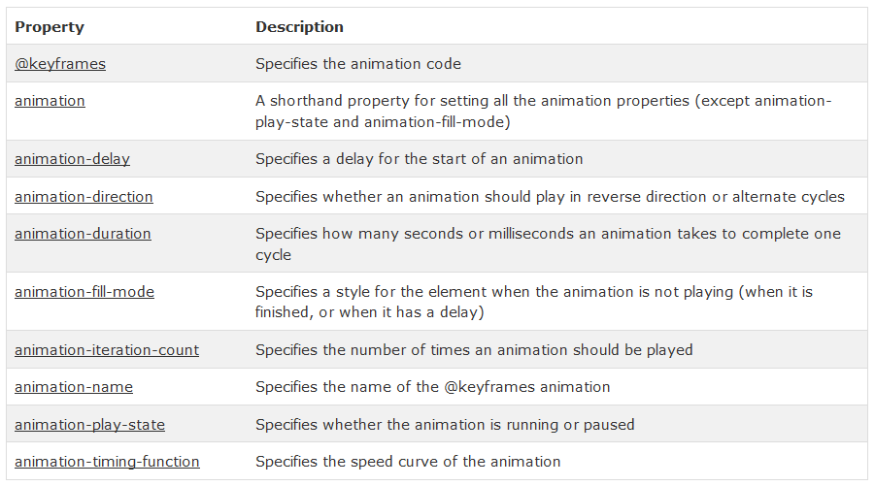
CSS3 Animation
CSS3 Animation Properties

Slide 5
CSS3 Animation
Let’s Practice Again

Slide 6
How to Use Photoshop(PSD to HTML)
Introduction of photoshop.
How to use photoshop for cropping PSD file for html conversion?
How to select transparent layer using photo shop?
Some basic short cut key of photoshop.

